Slide 1

OBJECT DETECTION SYSTEM

Slide 2

CONTENTS
PROJECT OVERVIEW
USE CASES OF OBJECT DETECTION
IMPLEMENTATION DETAILS
TAKEAWAYS FROM THE PROGRAM

Slide 3
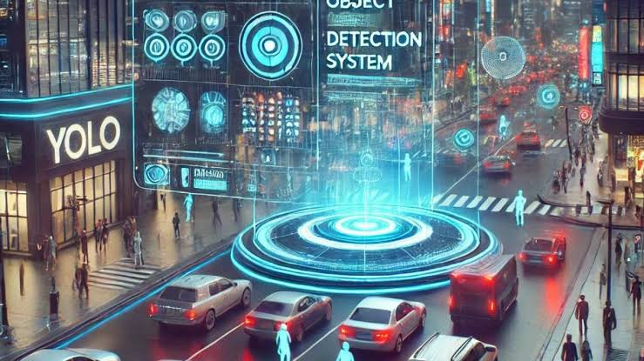
PROJECT OVERVIEW: object detection system
Core AlgorithmYOLOv8 Nano: Lightweight, real-time object detection optimized for CPUs. Perfect for edge applications with resource constraints.
Custom Dataset Training : Model trained on user-specific images with labeled bounding boxes. Ensures high accuracy tailored to the target use case.
Web App Integration Developed using Flask for seamless usability. Features: Train the Model: Users can train the model with new data. Real-Time Detection: Detect objects via images, webcam, and video inputs.
Key Benefits Efficiency: Real-time performance even on low-power devices. Customization: Tailored detection capabilities for specific user needs. Accessibility: User-friendly interface for training and detection.

Slide 4
USE CASES OF OBJECT DETECTION SYSTEM
Applications across industries

Slide 5
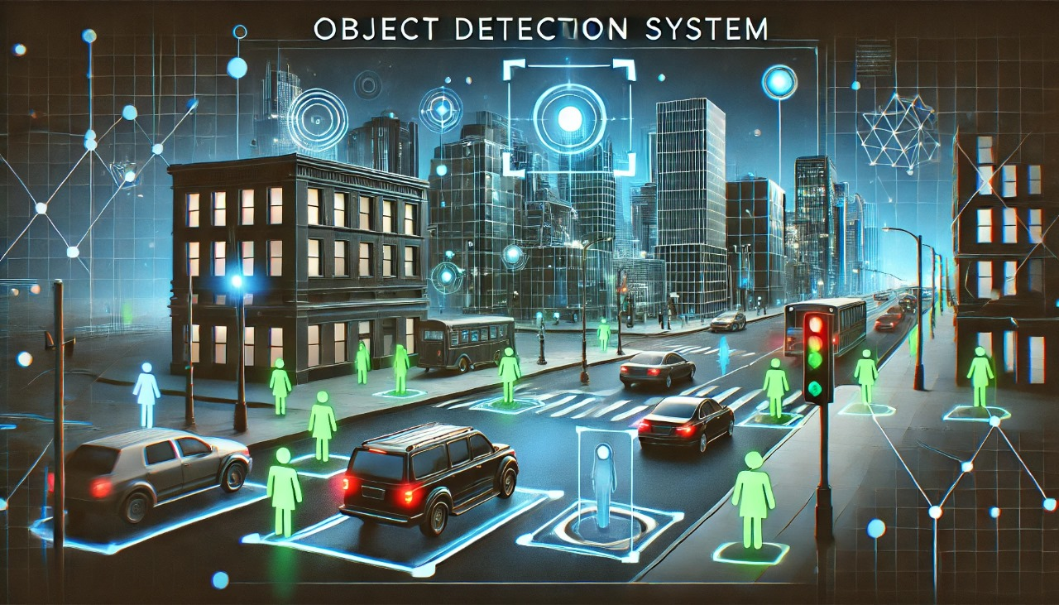
SECURITY & SURVILANCE
Use Case: Designed for public spaces like parks, subway stations, and shopping malls.
Functionality
Advanced Object Detection: Continuous monitoring to detect and identify objects such as people, bags, and vehicles.
Real-Time Anomaly Detection: Highlights irregularities or threats as they occur.
Impact
Proactive Response: Enables immediate action to mitigate potential threats.
Enhanced Safety: Ensures security across critical infrastructures and urban areas.

Slide 6
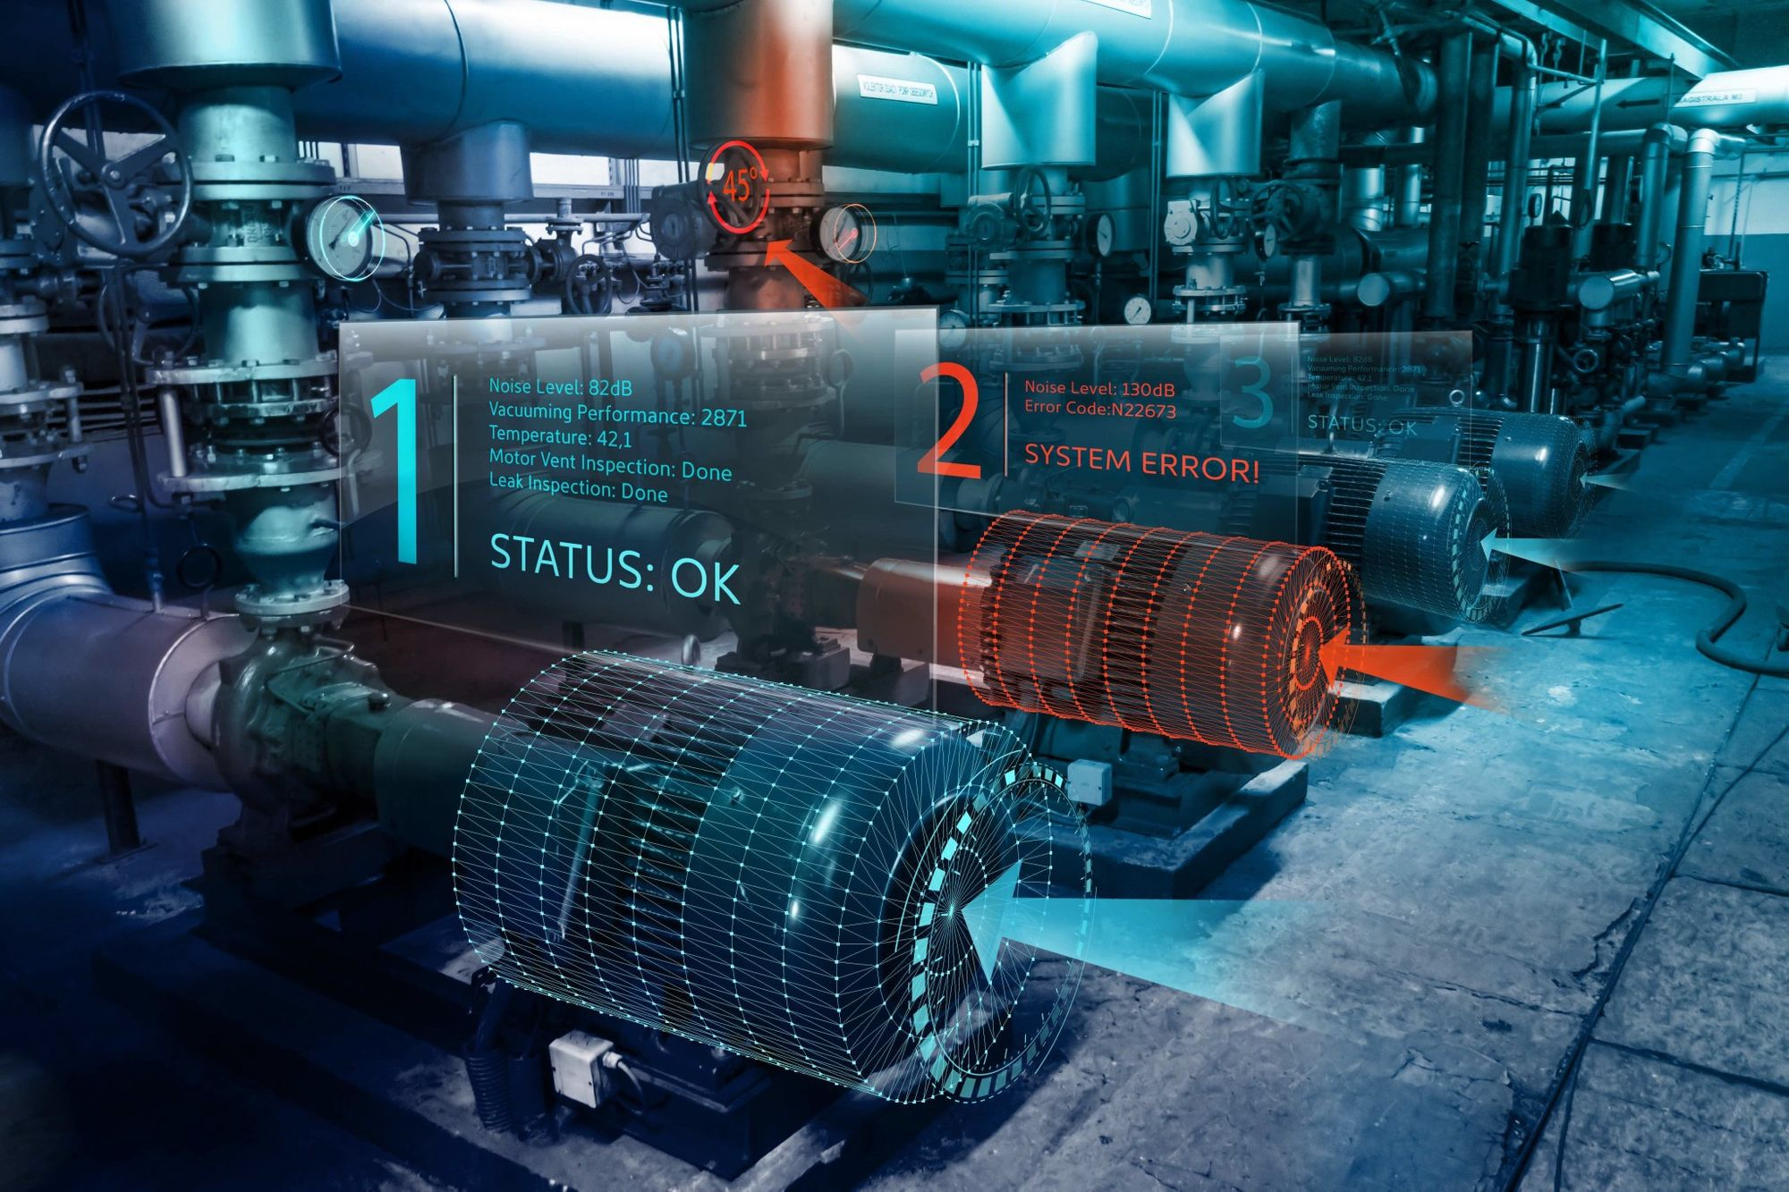
MANUFACTORING SECTOR
Tool and Part Recognition
Train the model to recognize all tools, equipment, and parts in the facility.
Label items with their name, purpose, handling, and maintenance details.
Interactive Employee Training
Use a camera to identify tools and display real-time info like name, use, and safety tips.
Offer step-by-step tutorials for using tools or assembling parts.
Boosting Knowledge Retention
Combine visual recognition with hands-on practice on the shop floor.
Add quizzes or challenges to make learning fun
Continuous Learning and Updates
Update the system with new tools and parts as processes change.
Track employee progress and highlight areas needing improvement.

Slide 7
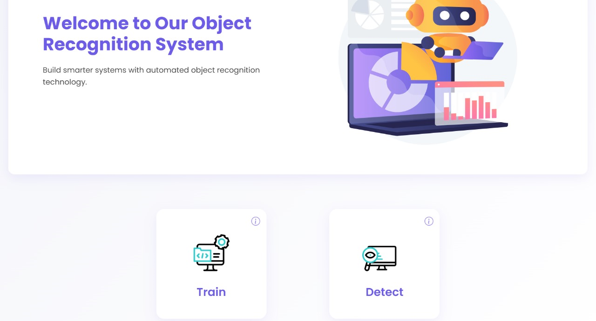
IMPLEMENTATION DETAILS
Key Features:
Interactive Object Detection:
Detect objects in real time across different input sources.
Image Upload:
Users can upload images for instant object detection.
Webcam Detection:
Enables live object detection through webcam feeds.
Video Input:
Supports object detection for user-uploaded videos.

Slide 8
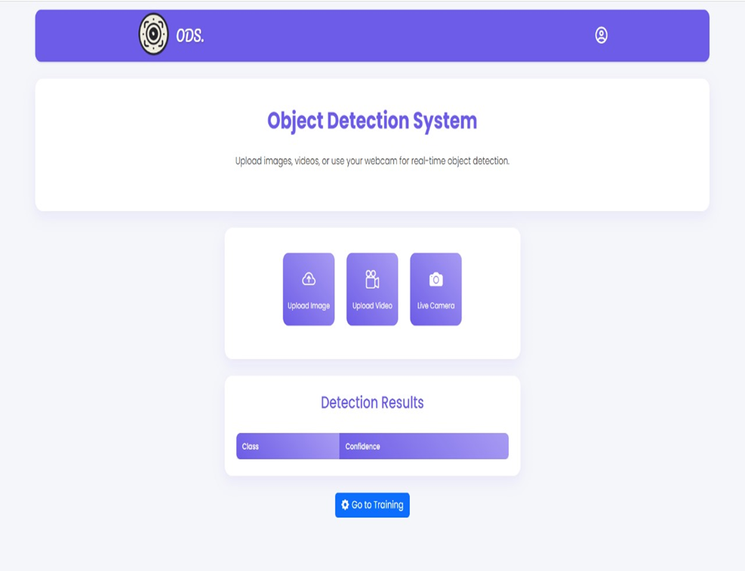
IMPLEMENTATION DETAILS
System Highlights:
Model Training:
Trained using YOLOv8 Nano on custom datasets, achieving optimized detection performance after training for over 50 epochs.
Flask Web Integration:
Seamless integration with a Flask web application, providing an interactive interface for login, object training, and real-time detection.
Real-Time Performance:
Optimized for fast and accurate object detection, enabling real-time performance on video input and webcam feeds.

Slide 9
TAKEAWAYS FROM THIS PROGRAM
Collaboration and Teamwork
Planning and Execution
Artificial Intelligence (AI) and Object Detection
Professionalism
Industry Disruption with Technology
Time Management and Accountability

Slide 10

THANK YOU
By Our Team
This internship was an incredible learning experience that not only enriched our technical knowledge but also honed our soft skills essential for thriving in a professional environment.

